Slide 1
Product Production Tree
First of all, we must determine all the stages starting from the raw material to the final product. The reason we do this is to see the big picture. Later, by examining the big picture and applying some methods, bottlenecks and problems in production will be identified.
For this reason, we created the product production tree. You can see it next slayt the Figure-1 below.

Slide 2
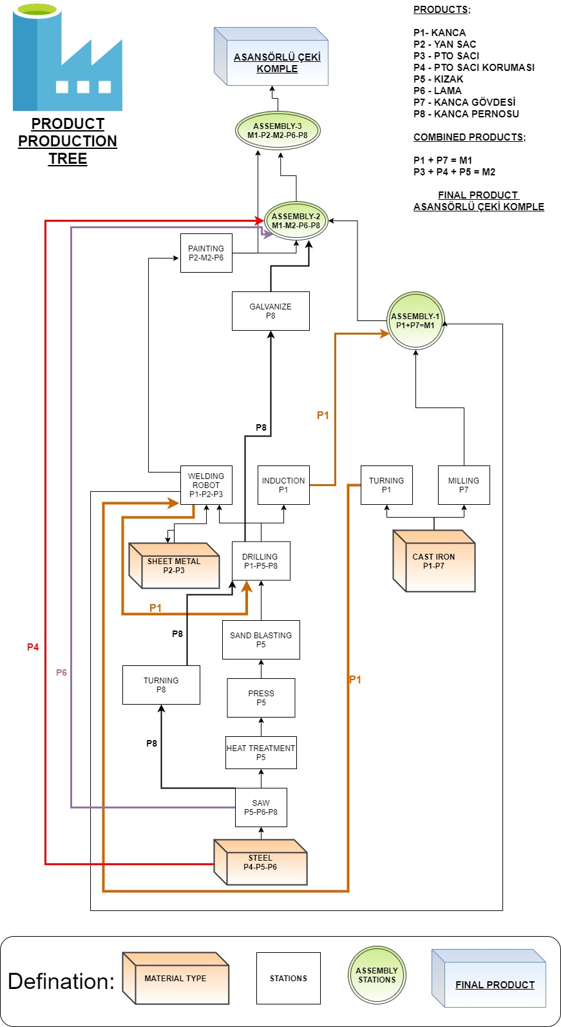
Figure-1

Slide 3
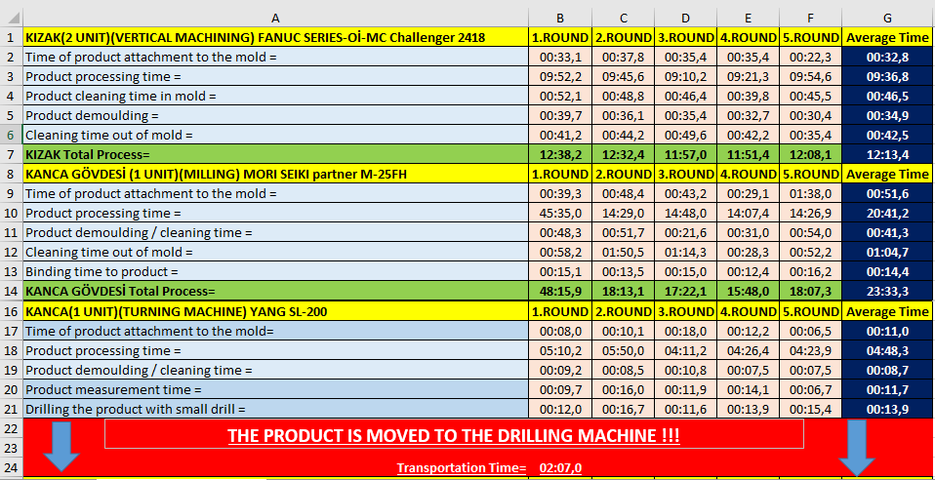
Work Time Study
We made time measurements by doing a work-time study at the stages we set in the product tree.
As a result of the time measurements we made on the production line of the factory; We obtained the data in Figure-2 and Figure-3 regarding the production line.
Figure-2

Slide 4
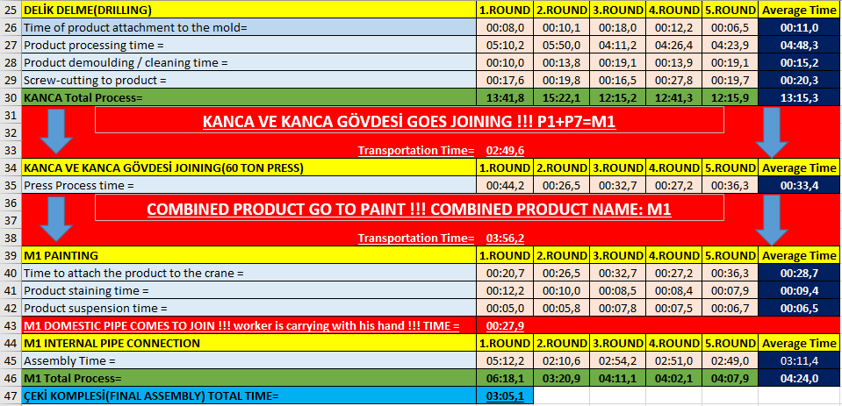
Figure-3
Using these data with the help of our methodologies, we reached the results in Figüre-4. Here we have benefited from Microsoft Office applications Microsoft Excel.

Slide 5
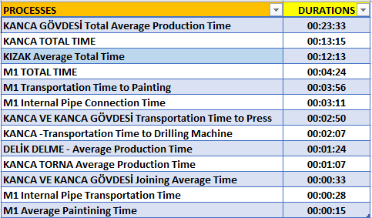
Processing of Datas
Here we analyzed the data using microsoft excel program.
Figure-4

Slide 6
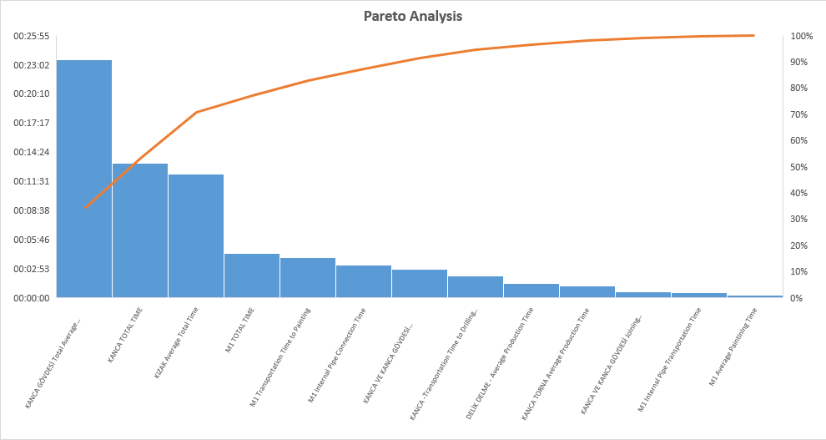
Pareto Analysis
Applying Pareto Analysis in our project, we identified the stations and bottlenecks where there were major problems. You can see the Figure-5 below.
Figure-5

Slide 7
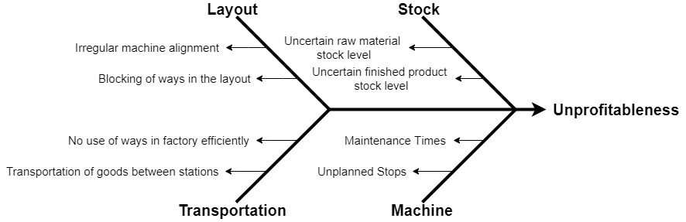
Fishbone Diagram
Also, the fishbone diagram or Ishikawa diagram is a cause-and-effect diagram that helps managers to track down the reasons for imperfections, variations, defects, or failures. We made a fishbone diagram for our project. You can see the Figure-6 below.
Figure-6

Slide 8
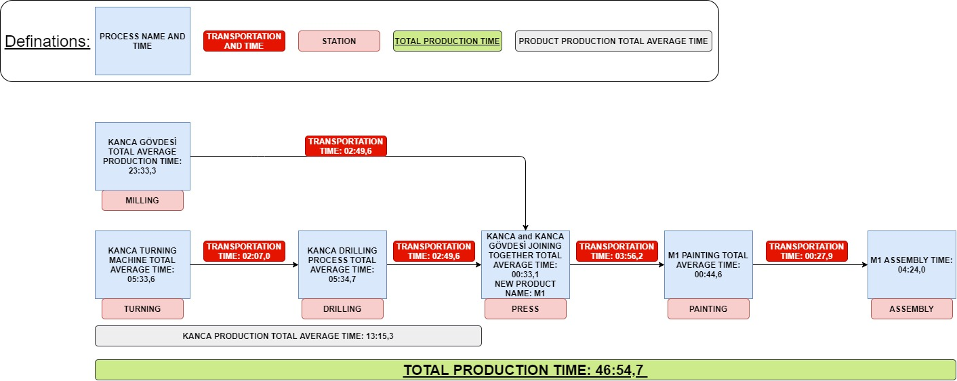
Bottlenecks
As a result of work-time study and pareto analysis, problematic stations were identified. The time measurements at those stations are shown in the Figure-7 below.
Figure-7

Slide 9
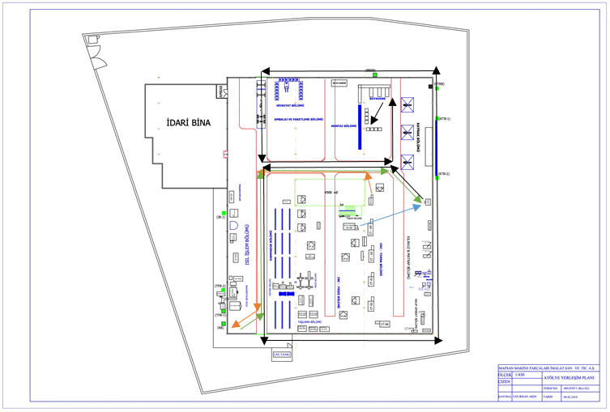
Transportation of Goods Between Stations
As shown in these measurements, the transportation time of the product in the factory is very large and it causes bottlenecks and losses in the system. The movements of the product in the factory are shown in Figure-8 below.
Figure-8

Slide 10
Transportation of Goods Between Stations
Products that come as raw materials are first processed in turning and milling stations. The parts coming out of turning station follow the path indicated by the orange arrows to the drill station and drill. Afterwards, they move on the path indicated by green arrows and come to the press process. In the parts coming out of the milling station, it comes to the press operation with the path indicated by the blue arrow. Here, these two types of products are combined into a single product. After this process, the combined product comes to the painting station by following the path indicated by the black arrows. After painting, our product follows the path indicated by black arrows and arrives at the final station, the assembly station. And here the final product is completed.

Slide 11
Solution Approach
Automated Layout Design Programe(ALDEP) was developed at IBM and originally offered by Seehof and Evans. ALDEP is primarily an enterprise algorithm. However, due to the evaluation process used in accepting or rejecting a given placement scheme, it can also be considered as a development program. ALDEP designs the layout without the need for an existing layout, such as layout layout programs. However, it also compares solutions that emerge similar to the method used in a development algorithm.
Although ALDEP has many different application forms, this section will describe the random selection method. The random selection method of ALDEP is to develop a layout design by briefly selecting a section randomly and placing it within the placement order.

Slide 12
ALDEP
A relationship diagram is created using the codes in the relationship table. The relationship codes are given in the table below.
Code | Defination
A | Absolutely necessary that these two departments be next to each other
E | Especially important
I | Important
O | Ordinary importance
U | Unimportant
X | Closeness undesirable

Slide 13
ALDEP
The numerical values ​​that ALDEP assigns to proximity degrees are as follows (Francis, 1974):
A = 4³= 64 | O = 4⁰
E = 4² = 16 | U = 0
I = 4¹= 4 | X = -4⁵ = -1.024
Then, the relationship table is examined and placed in a section layout that shows a high degree of affinity (For example (A or E). This process is continued until all sections are placed or there are no sections suitable for placement of the sections placed. If there are such sections, one of them is randomly selected and placed in the order
The selection process continues until all the sections are placed in the order. The total score of the placement order is determined by adding the numerical values ​​given for the adjacent sections according to their degree of proximity.

Slide 14
ALDEP
ALDEP is capable of realizing solutions up to 63 sections or actions and can realize multi-layered layouts up to three floors. In addition, it is possible to add some restrictions to the solution. For example; The layout can be designed around passages, elevator shafts, stairwells, g, r, jobs and existing sections.
The required inputs for ALDEP can be listed as follows:
Length, width and space requirements for each floor,
Scale of the implanted projection,
Number of sections in the layout,
Number of layouts that can be derived,
The minimum score required for an acceptable placement order,
Smallest section preference,
Relationship table for departments,
The layout and dimensions of the restricted areas for each floor.

Slide 15
ALDEP
It is also necessary to know the building boundaries, as the length, width and area requirements must be determined for each floor. If a new design is placed in the existing facility, the boundaries of the building will be the boundaries of the new facility. When the design is not limited to the existing facility, a preliminary work is required to determine the desired building boundaries.
ALDEP is designed to avoid boundaries that make extreme zigzags using the vertical analysis method in placing the sections. Basically, the placement area area is filled using certain long and wide vertical stripes equal to the depth of the placement layout. The method can be animated considering a strip roll of a certain width. One length of the strips is one slice of the roll. The area of ​​the strip corresponds to the area of ​​the section. The ribbon is placed in the layout.

Slide 16
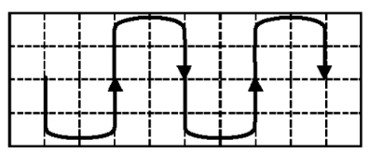
ALDEP
. When the length of the strip is greater than the depth of the insertion arrangement, the strip is cut and the increased portion is placed next to the strip piece previously placed. The analysis model used is basically as shown in Figure-9. Despite all the efforts made to avoid the irregular section boundaries, such situations are still encountered.
Figure-9

Slide 17
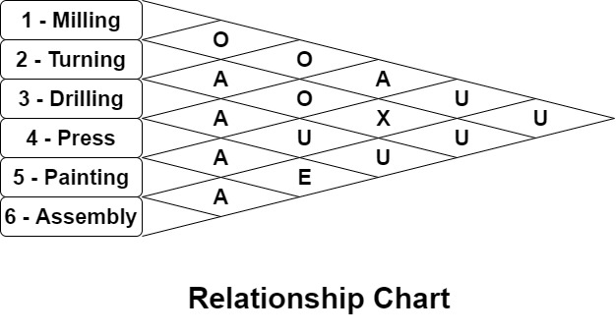
Relationship Chart
Proximity relationships between stations, which we previously detected were bottlenecks. These relationships were determined by taking information from the observations made, employees and authorized engineers. The detected relationships are shown in Figure-10 below.
Figure-10

Slide 18
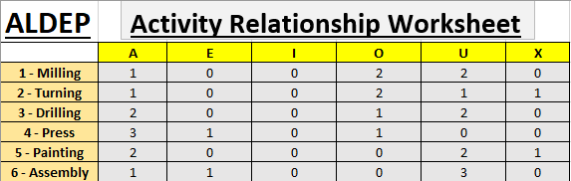
Activity Relationship Worksheet
After that we made Activity Relatioship Worksheet. Here, all the relations that the stations have are identified and written. You can see it in Figure-11.
Figure-11

Slide 19
Finding Layout Vector
First of all, stations with 'A' proximity relation are selected. And these are examined within themselves. The station with greater proximity relationship 'A' is selected and becomes the first station of the proximity relationship sequence. If 'A' proximity relations are equal, 'E' proximity relations are checked. If they are equal, 'I' proximity relationships are checked. With this rule, you can go by looking towards other proximity relationships. In this order, stations are selected and added to the order of proximity relations.

Slide 20


Finding Layout Vector
Here our first station for sequence of proximity relationships is 4 - Press. Because it has biggest A relationship value. You can see it in Figure-12.
Figure-12
Our second station is 3 - Drilling. And, our third station is '5 - Painting'. For now, our sequence of proximity relationships; ‘4 - 3 - 5 –‘. You can see it in Figure-13.
Figure-13

Slide 21


Finding Layout Vector
Our fourth station is '6 - Assembly'. For now, our sequence of proximity relationships; 4 - 3 - 5 - 6 -. You can see it in Figure-14.
Figure-14
Our fifth station is '1 - Milling'. And, only '2 - Turning' station remains. It is the sixth station. Our sequence of proximity relationships; '4 - 3 - 5 - 6 - 1 - 2'. You can see it in Figure-15.
Figure-15

Slide 22
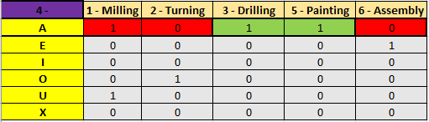
We get Sequence of Proximity Relationships after all these processes.
Now, the relationship between station '4 - Press' and other stations will be examined and a new layout vector will be found. You can see it in Figure-16.
Figure-16

Slide 23
Finding Layout Vector
There is equality here. Proximity relations A of stations 3 and 5 are equal. In order for this equality to deteriorate, we have to look at their order in the relationship of intimacy. Station 3 was ranked earlier than station 5 in order of proximity relationship. As a result, we choose station number 3. Our second station is '3 - Drilling'. And we take away station number 3 from the table. This process will continue in the same way for other stations. For now, our layout vector is; '4 - 3 -'. You can see it in Figure-17.
Figure-17

Slide 24
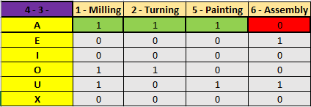
Finding Layout Vector
Now we will look at the proximity relations between station 3 and other stations. We will do the same for every station added to the layout vector. You can see it in Figure-18.
Figure-18
Again there is a equality here. So we have to look their sequence of proximity relationships. We found before. Station 5 is before station 2 and station 1. So, our third station is '5 - Painting'. For now, our layout vector is; '4 - 3 - 5 -'. You can see it in Figure-18.

Slide 25
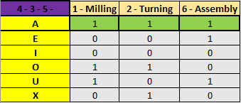
Finding Layout Vector
Now we will look at the proximity relations between station 5 and other stations. We will do the same for every station added to the layout vector. You can see it in Figure-19.
Figure-19
There is a equality here. So we have to look their sequence of proximity relationships. Station 6 is before station 2 and station 1. So, our fourth station is '6 - Assembly'. For now, our layout vector is; '4 - 3 - 5 - 6 - '. You can see it in Figure-19.

Slide 26
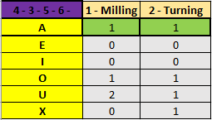
Finding Layout Vector
Now we will look at the proximity relations between station 6 and other stations. We will do the same for every station added to the layout vector. You can see it in Figure-20.
Figure-20
Again there is a equality here. So we have to look their sequence of proximity relationships. Station 1 is before station 2. So, our fifth station is '1 - Milling' and our sixth station is '2 - Turning'. Our layout vector is; '4 - 3 - 5 - 6 - 1 - 2'. You can see it in Figure-20.

Slide 27
Layout Vector
Finally, we get the Layout Vector. You can see it in Figure-21.
Figure-21

Slide 28
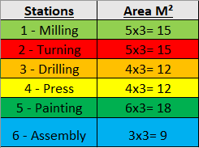

ALDEP Solution Steps
Use ALDEP procedure to determine the layout vector, construct and evaluate the layout for the facility based on the relationship chart and the station dimensions given below. You can see them Figure-22, Figure-23. The dimensions of the facility are 9x9. Use the sweep width of 3. One sweep width equals 1 M². The closeness values: A=64, E=16, I=4, O=1, U=0, X=-1024.
Figure-22
Figure-23

Slide 29
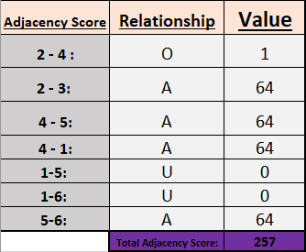
ALDEP Solution Steps
Adjacency score relations of the stations are determined from left to right. You can see it in Figure-24.
Figure-24

Slide 30
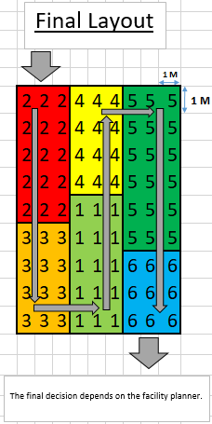
ALDEP Solution Steps
Layout construction. It is vertical sweep pattern. On the other hand, the production should be adjusted so as not to disturb the order. Because placement is made according to the product in this form of production. You can see it in Figure-25.
Figure-25

Slide 31
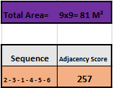
ALDEP Solution Steps
You can see total area for this layout, sequence and adjacency score in Figure-26.
Figure-26

